Slide 1
DATA ANALYTICS USING R
Dr.E.Sivasankar, NIT,Tiruchirappalli-15

Slide 2
Age of Big Data
“Data is a new class of economic asset, like currency and gold.”
Source: World Economic Forum 2012

Slide 3
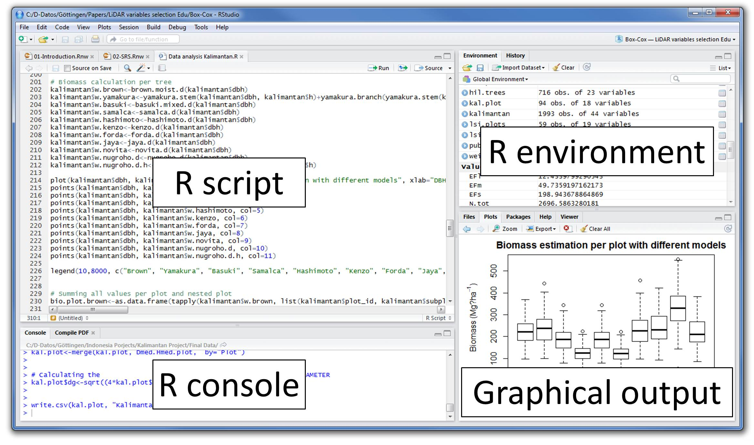

Slide 4
R Console: This area shows the output of code you run.
Also, you can directly write codes in console.
Code entered directly in R console cannot be traced later. This is where R script comes to use.
R Script: As the name suggest, here you get space to write codes.
To run those codes, simply select the line(s) of code and press Ctrl + Enter.
Alternatively, you can click on little ‘Run’ button location at top right corner of R Script.

Slide 5
R environment: This space displays the set of external elements added. This
includes data set, variables, vectors, functions etc. To check if data has
been loaded properly in R, always look at this area.
Graphical Output: This space display the graphs created during exploratory
data analysis. Not just graphs, you could select packages, seek help with
embedded R’s official documentation.

Slide 6
First Program & basic computations in R
# My first program in R Programming
myString <- "Hello, World!"
print ( myString)
Basic computations in R
> 2 + 3
> 5
> 6 / 3
> 2
> (3*8)/(2*3)
> 4
> log(12)
> 1.07
> sqrt (121)
> 11

Slide 7
Vector Objects
R has 5 basic classes of objects. This includes:
Character
Numeric (Real Numbers)
Integer (Whole Numbers)
Complex
Logical (True / False)
Let’s create vectors of different classes. We can create vector using c() or concatenate command also.
> a <- c(1.8, 4.5) #numeric
> b <- c(1 + 2i, 3 - 6i) #complex
> d <- c(23, 44) #integer
> e <- vector("logical", length = 5)

Slide 8
Vector Objects
v <- TRUE
print(class(v))
it produces the following result −
[1] "logical"
v <- 23.5
print(class(v))
it produces the following result −
[1] "numeric"

Slide 9
Data Types in R
Vector: A vector contains object of same class. But, you can mix objects of different classes too. When objects of different classes are mixed in a list, coercion occurs. This effect causes the objects of different types to ‘convert’ into one class.
# Create a vector.
apple <- c("red", "green"," yellow")
print(apple)
# Get the class of the vector.
print(class(apple))
Result
[1] "red" "green" "yellow"
[1] "character"

Slide 10
Arithmetic Operators in R
v <- c( 2,5.5,6)
t <- c(8, 3, 4)
print(v+t)
it produces the following result −
[1] 10.0 8.5 10.0
v <- c( 2,5.5,6)
t <- c(8, 3, 4)
print(v-t)
it produces the following result −
[1] -6.0 2.5 2.0

Slide 11
Arithmetic Operators in R
The first vector raised to the exponent of second vector
v <- c( 2,5.5,6)
t <- c(8, 3, 4)
print(v^t)
it produces the following result −
[1] 256.000 166.375 1296.000

Slide 12
Relational Operators in R
v <- c(2,5.5,6,9)
t <- c(8,2.5,14,9)
print(v>t)
it produces the following result −
[1] FALSE TRUE FALSE FALSE
v <- c(2,5.5,6,9)
t <- c(8,2.5,14,9)
print(v<=t)
it produces the following result −
[1] TRUE FALSE TRUE TRUE

Slide 13
v <- c(2,5.5,6,9)
t <- c(8,2.5,14,9)
print(v!=t)
it produces the following result −
[1] TRUE TRUE TRUE FALSE
v <- c(2,5.5,6,9)
t <- c(8,2.5,14,9)
print(v == t)
it produces the following result −
[1] FALSE FALSE FALSE TRUE

Slide 14
List
A list is an R-object which can contain many different types of elements inside it like vectors, functions and even another list inside it.
# Create a list.
list1 <- list(c(2,5,3),21.3,sin)
# Print the list.
print(list1)
When we execute the above code, it produces the following result −
[[1]]
[1] 2 5 3
[[2]]
[1] 21.3
[[3]]
function (x) .Primitive("sin")

Slide 15
Matrix
A matrix is a two-dimensional rectangular data set.
It can be created using a vector input to the matrix function.
# Create a matrix.
M = matrix( c('a','a','b','c','b','a'), nrow = 2, ncol = 3, byrow = TRUE)
print(M)
When we execute the above code, it produces the following result −
[,1] [,2] [,3]
[1,] "a" "a" "b"
[2,] "c" "b" "a"

Slide 16
Working with Matrix in R
# Create two 2x3 matrices.
matrix1 <- matrix(c(3, 9, -1, 4, 2, 6), nrow = 2)
print(matrix1)
matrix2 <- matrix(c(5, 2, 0, 9, 3, 4), nrow = 2)
print(matrix2)
# Multiply the matrices.
result <- matrix1 * matrix2
cat("Result of multiplication","\n")
print(result)
# Divide the matrices
result <- matrix1 / matrix2
cat("Result of division","\n")
print(result)

Slide 17
Working with Matrix in R
When we execute the above code, it produces the following result −
[,1] [,2] [,3]
[1,] 3 -1 2
[2,] 9 4 6
[,1] [,2] [,3]
[1,] 5 0 3
[2,] 2 9 4
Result of multiplication
[,1] [,2] [,3]
[1,] 15 0 6
[2,] 18 36 24
Result of division
[,1] [,2] [,3]
[1,] 0.6 -Inf 0.6666667
[2,] 4.5 0.4444444 1.5000000

Slide 18
Arrays
While matrices are confined to two dimensions, arrays can be of any number of dimensions. The array function takes a dim attribute which creates the required number of dimension.
In the below example we create an array with two elements which are 3x3 matrices each.

Slide 19
Arrays
# Create an array.
a <- array(c('green',' yellow'),dim = c(3,3,2))
print(a)
When we execute the above code, it produces the following result −
, , 1
[,1] [,2] [,3]
[1,] "green" "yellow" "green"
[2,] "yellow" "green" "yellow"
[3,] "green" "yellow" "green"
, , 2
[,1] [,2] [,3]
[1,] "yellow" "green" "yellow"
[2,] "green" "yellow" "green"
[3,] "yellow" "green" "yellow

Slide 20
Arrays
# Create two vectors of different lengths.
vector1 <- c(5,9,3)
vector2 <- c(10,11,12,13,14,15)
# Take these vectors as input to the array.
result <- array(c(vector1,vector2),dim = c(3,3,2))
print(result)
When we execute the above code, it produces the following result −
, , 1
[,1] [,2] [,3]
[1,] 5 10 13
[2,] 9 11 14
[3,] 3 12 15
, , 2
[,1] [,2] [,3]
[1,] 5 10 13
[2,] 9 11 14
[3,] 3 12 15

Slide 21
Data Frames
Data frames are tabular data objects. Unlike a matrix in data frame each column can contain different modes of data. The first column can be numeric while the second column can be character and third column can be logical.
It is a list of vectors of equal length.
Data Frames are created using the data.frame() function.

Slide 22
Data Frames
# Create the data frame.
BMI <- data.frame(
gender = c("Male", "Male","Female"),
height = c(152, 171.5, 165),
weight = c(81,93, 78),
Age = c(42,38,26)
)
print(BMI)
When we execute the above code, it produces the following result −
gender height weight Age
1 Male 152.0 81 42
2 Male 171.5 93 38
3 Female 165.0 78 26

Slide 23
Factors
Factors are the r-objects which are created using a vector. It stores the vector along with the distinct values of the elements in the vector as labels. The labels are always character irrespective of whether it is numeric or character or Boolean etc. in the input vector. They are useful in statistical modeling.
Factors are created using the factor() function. The nlevels functions gives the count of levels.

Slide 24
# Create a vector.
apple_colors <- c('green','green','yellow','red','red','red','green')
# Create a factor object.
factor_apple <- factor(apple_colors)
# Print the factor.
print(factor_apple)
print(nlevels(factor_apple))
When we execute the above code, it produces the following result −
[1] green green yellow red red red green
Levels: green red yellow
# applying the nlevels function we can know the number of distinct values
[1] 3

Slide 25
for loop
for – This structure is used when a loop is to be executed fixed number of times.
It is commonly used for iterating over the elements of an object (list, vector).
Syntax:
for (<search condition>){
#do something
}

Slide 26
Example
#initialize a vector
y <- c(99,45,34,65,76,23)
#print the first 4 numbers of this vector
for(i in 1:4){
print (y[i])
}
[1] 99
[1] 45
[1] 34
[1] 65

Slide 27
While loop
It begins by testing a condition, and executes only if the condition is found to be true. Once the loop is executed, the condition is tested again. Hence, it’s necessary to alter the condition such that the loop doesn’t go infinity.

Slide 28
While loop
Example:
#initialize a condition
Age <- 12
#check if age is less than 17
while(Age < 17){
print(Age)
Age <- Age + 1 #Once the loop is executed, this code breaks the loop
}
[1] 12
[1] 13
[1] 14
[1] 15
[1] 16

Slide 29
if else statement
if else statement -This structure is used to test a condition.
syntax:
if (<condition>){
##do something
} else {
##do something
}
Example
#initialize a variable
N <- 10
#check if this variable * 5 is > 40
if (N * 5 > 40){
print("This is easy!")
} else {
print ("It's not easy!")
}
[1] "This is easy!

Slide 30
Function
A function is a set of statements organized together to perform a specific task.
R has a large number of in-built functions and the user can create their own functions.
function_name <- function(arg_1, arg_2, ...) {
Function body
}

Slide 31
Built-in Function
Simple examples of in-built functions are seq(), mean(), max(), sum(x) and paste(...) etc. They are directly called by user written programs.
# Create a sequence of numbers from 32 to 44.
print(seq(32,44))
# Find mean of numbers from 25 to 82.
print(mean(25:82))
# Find sum of numbers frm 41 to 68.
print(sum(41:68))
When we execute the above code, it produces the following result −
[1] 32 33 34 35 36 37 38 39 40 41 42 43 44
[1] 53.5
[1] 1526

Slide 32
User defined function
# Create a function to print squares of numbers in sequence.
new.function <- function(a) {
for(i in 1:a) {
b <- i^2
print(b)
}}
# Call the function new.function supplying 6 as an argument.
new.function(6)
When we execute the above code, it produces the following result −
[1] 1
[1] 4
[1] 9
[1] 16
[1] 25
[1] 36

Slide 33
Variable
Variable provides us with named storage that our programs can manipulate.
A variable in R can store an atomic vector, group of atomic vectors or a combination of many R objects.
A valid variable name consists of letters, numbers and the dot or underline characters.
The variable name starts with a letter or the dot not followed by a number.
Example
var_name2. valid Has letters, numbers, dot and underscore
.var_name ,
var.name valid can start with a dot(.) but the dot(.)should not be followed by a number.

Slide 34
Variable Assignment
The variables can be assigned values using leftward, rightward and equal to operator.
The values of the variables can be printed using print() or cat()function. The cat()
function combines multiple items into a continuous print output.
Example
# Assignment using equal operator.
var.1 = c(0,1,2,3)
# Assignment using leftward operator.
var.2 <- c("learn","R")
# Assignment using rightward operator.
c(TRUE,1) -> var.3

Slide 35
print(var.1)
cat ("var.1 is ", var.1 ,"\n")
cat ("var.2 is ", var.2 ,"\n")
cat ("var.3 is ", var.3 ,"\n")
When we execute the above code, it produces the following result -
[1] 0 1 2 3
var.1 is 0 1 2 3
var.2 is learn R
var.3 is 1 1

Slide 36
Data Type of a Variable
In R, a variable itself is not declared of any data type, rather it gets the data type of the
R - object assigned to it.
So R is called a dynamically typed language, which means that we canchange a variable’s data type of the same variable again and again when using it in a program.
var_x <- "Hello"
cat("The class of var_x is ",class(var_x),"\n")
var_x <- 34.5
cat(" Now the class of var_x is ",class(var_x),"\n")
var_x <- 27L
cat(" Next the class of var_x becomes ",class(var_x),"\n")

Slide 37
Finding Variables
To know all the variables currently available in the workspace we use the ls() function.
Also the ls() function can use patterns to match the variable names.
print(ls())
When we execute the above code, it produces the following result -
[1] "my var" "my_new_var" "my_var" "var.1"
[5] "var.2" "var.3" "var.name" "var_name2."
[9] "var_x" "varname"

Slide 38
Deleting Variables
Variables can be deleted by using the rm() function. Below we delete the variable var.3. On printing the value of the variable error is thrown.
rm(var.3)
All the variables can be deleted by using the rm() and ls() function together.
rm(list = ls())
print(ls())

Slide 39
Packages
R packages are a collection of R functions, complied code and sample data.
They are stored under a directory called "library" in the R environment.
By default, R installs a set of packages during installation.
More packages are added later, when they are needed for some specific purpose.
When we start the R console, only the default packages are available by default.
To check available R Packages
Get library locations containing R packages
.libPaths()

Slide 40
Get the list of all the packages installed
library()
When we execute the above code, it produces the following result.
Packages in library ‘C:/Program Files/R/R-3.2.2/library’:
base The R Base Package
boot Bootstrap Functions (Originally by Angelo Canty for S)
class Functions for Classification
cluster "Finding Groups in Data": Cluster AnalysisExtended Rousseeuw et al.
codetools Code Analysis Tools for R
compiler The R Compiler Package

Slide 41
Install directly from CRAN
The following command gets the packages directly from CRAN webpage and installs the package in the R environment.
You may be prompted to choose a nearest mirror. Choose the one appropriate to your location.
install.packages("Package Name")
Example
# Install the package named "XML".
install.packages("XML")

Slide 42
Install package manually
To install package manually
Go to the link R Packages to download the package needed. Save the package as a .zip file in a suitable location in the local system.
Now you can run the following command to install this package in the R environment.
install.packages(file_name_with_path, repos = NULL, type = "source")
# Install the package named "XML"
install.packages("E:/XML_3.98-1.3.zip", repos = NULL, type = "source")

Slide 43
R - Strings
Any value written within a pair of single quote or double quotes in R is treated as a string. Internally R stores every string within double quotes, even when you create them with single quote.
a <- 'Start and end with single quote'
print(a)
b <- "Start and end with double quotes"
print(b)
1] "Start and end with single quote"
[1] "Start and end with double quotes"

Slide 44
Concatenating Strings - paste() function
Syntax
paste(..., sep = " ", collapse = NULL)
... represents any number of arguments to be combined.
sep represents any separator between the arguments. It is optional.
collapse is used to eliminate the space in between two strings.
a <- "Hello"
b <- 'How'
c <- "are you? "
print(paste(a,b,c))
print(paste(a,b,c, sep = "-"))
print(paste(a,b,c, sep = "", collapse = ""))
When we execute the above code, it produces the following result −
[1] "Hello How are you? "
[1] "Hello-How-are you? "
[1] "HelloHoware you? "

Slide 45
R - Strings
Changing the case - toupper() & tolower() functions
These functions change the case of characters of a string.
Syntax
The basic syntax for toupper() & tolower() function is −
toupper(x)
tolower(x)
The basic syntax for substring() function is −
substring(x,first,last)
# Extract characters from 5th to 7th position.
result <- substring("Extract", 5, 7)
print(result)
[1] "act"

Slide 46
R - Time Series Analysis
syntax for creating a pie-chart using the R is −
Syntax
The basic syntax for ts() function in time series analysis is −
timeseries.object.name <- ts(data, start, end, frequency)
the parameters used are
data is a vector or matrix containing the values used in the time series.
start specifies the start time for the first observation in time series.
end specifies the end time for the last observation in time series.
frequency specifies the number of observations per unit time.

Slide 47
R - Time Series Analysis
# Get the data points in form of a R vector.
rainfall <- c(799,1174.8,865.1,1334.6,635.4,918.5,685.5,998.6,784.2,985,882.8,1071)
# Convert it to a time series object.
rainfall.timeseries <- ts(rainfall, start = c(2012,1),frequency = 12)
# Print the time series data.
print(rainfall.timeseries)
# Give the chart file a name.
png(file = "rainfall.png")
# Plot a graph of the time series.
plot(rainfall.timeseries)
# Save the file.
dev.off()

Slide 48
R - Pie-chart
syntax for creating a pie-chart using the R is −
pie(x, labels, radius, main, col, clockwise)
description of the parameters used −
x is a vector containing the numeric values used in the pie chart.
labels is used to give description to the slices.
radius indicates the radius of the circle of the pie chart.(value between −1 and +1).
main indicates the title of the chart.
col indicates the color palette.
clockwise is a logical value indicating if the slices are drawn clockwise or anti clockwise.

Slide 49
R - Pie-chart
# Create data for the graph.
x <- c(21, 62, 10, 53)
labels <- c("London", "New York", "Singapore", "Mumbai")
# Give the chart file a name.
png(file = "city.jpg")
# Plot the chart.
pie(x,labels)
# Save the file.
dev.off()

Slide 50
R - Bar chart
A bar chart represents data in rectangular bars with length of the bar proportional
to the value of the variable. R uses the function barplot() to create bar charts.
Syntax
barplot(H, xlab, ylab,main, names.arg, col)
H is a vector or matrix containing numeric values used in bar chart.
xlab is the label for x axis.
ylab is the label for y axis.
main is the title of the bar chart.
names.arg is a vector of names appearing under each bar.
col is used to give colors to the bars in the graph.

Slide 51
R – Bar chart
# Create the data for the chart
H <- c(7,12,28,3,41)
M <- c("Mar","Apr","May","Jun","Jul")
# Give the chart file a name
png(file = "barchart_months_revenue.png")
# Plot the bar chart
barplot(H,names.arg=M,xlab="Month",ylab="Revenue",col="blue",
main="Revenue chart",border="red")
# Save the file
dev.off()

Slide 52
Regression analysis
It is a very widely used statistical tool to establish a relationship model between two variables. One of these variable is called predictor variable whose value is gathered through experiments. The other variable is called response variable whose value is derived from the predictor variable.
The general mathematical equation for a linear regression is −
y = ax + b
y is the response variable.
x is the predictor variable.
a and b are constants which are called the coefficients.

Slide 53
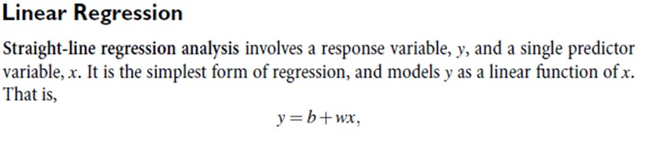
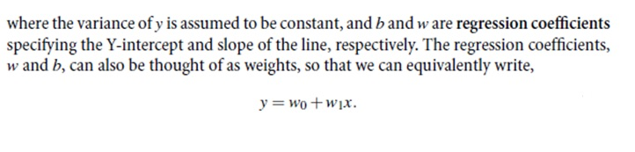

Slide 54
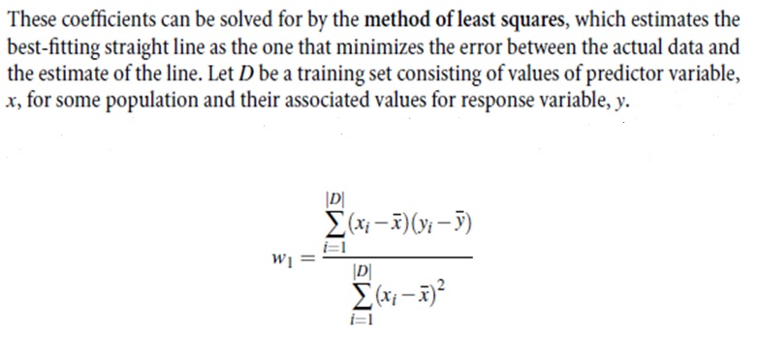

Slide 55
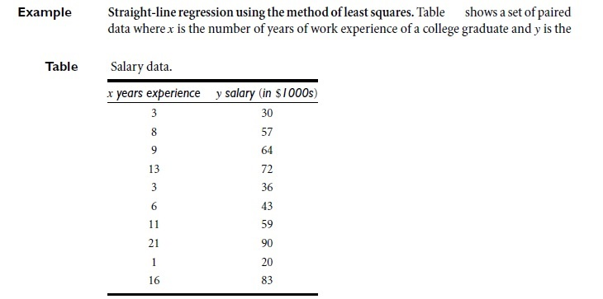

Slide 56
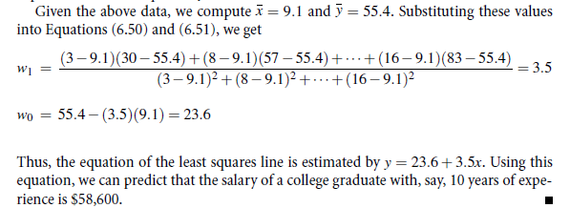

Slide 57
Regression analysis
lm() Function
This function creates the relationship model between the predictor and the response variable.
Syntax
lm(formula,data)
x <- c(3, 8, 9, 13, 3, 6, 11, 21, 1, 16)
y <- c(30, 57, 64, 72, 36, 43, 59, 90, 20, 83)
# Apply the lm() function.
relation <- lm(y~x)
print(relation)

Slide 58
Regression analysis
lm() Function
This function creates the relationship model between the predictor and the response variable.
Syntax
lm(formula,data)
x <- c(151, 174, 138, 186, 128, 136, 179, 163, 152, 131)
y <- c(63, 81, 56, 91, 47, 57, 76, 72, 62, 48)
# Apply the lm() function.
relation <- lm(y~x)
print(relation)

Slide 59
Regression analysis
Output
lm(formula = y ~ x)
Coefficients:
(Intercept) x
-38.4551 0.6746

Slide 60
Multiple Regression
In simple linear relation we have one predictor and one response variable, but in multiple regression we have more than one predictor variable and one response variable.
The general mathematical equation for multiple regression is −
y = a + b1x1 + b2x2 +...bnxn
Where y is the response variable.
a, b1, b2...bn are the coefficients.
x1, x2, ...xn are the predictor variables.
)

Slide 61
Multiple Regression
lm() Function
This function creates the relationship model between the predictor and the response variable.
Syntax
The basic syntax for lm() function in multiple regression is −
lm(y ~ x1+x2+x3...,data)
Example
Consider a data set "mtcars" available in the R environment. It gives a comparison between different car models in terms of mileage per gallon (mpg), cylinder displacement("disp"), horse power("hp"), weight of the car("wt") and some more parameters.

Slide 62
Multiple Regression
input <- mtcars[,c("mpg","disp","hp","wt")]
# Create the relationship model.
model <- lm(mpg~disp+hp+wt, data = input)
# Show the model.
print(model)
# Get the Intercept and coefficients as vector elements.
cat("# # # # The Coefficient Values # # # ","\n")
a <- coef(model)[1]
print(a)
Xdisp <- coef(model)[2]
Xhp <- coef(model)[3]
Xwt <- coef(model)[4]
print(Xdisp)
print(Xhp) print(Xwt)

Slide 63
Logistic Regression
The Logistic Regression is a regression model in which the response variable (dependent variable) has categorical values such as True/False or 0/1.
Syntax
The basic syntax for glm() function in logistic regression is −
glm(formula,data,family)
The description of the parameters used is
formula is the symbol presenting the relationship between the variables.
data is the data set giving the values of these variables.
family is R object to specify the details of the model. It's value is binomial for logistic regression.

Slide 64
Logistic Regression
Example
The in-built data set "mtcars" describes different models of a car with their various engine specifications. In "mtcars" data set, the transmission mode (automatic or manual) is described by the column am which is a binary value (0 or 1). We can create a logistic regression model between the columns "am" and 3 other columns - hp, wt and cyl.
# Select some columns form mtcars.
input <- mtcars[,c("am","cyl","hp","wt")]
print(head(input))
input <- mtcars[,c("am","cyl","hp","wt")]
am.data = glm(formula = am ~ cyl + hp + wt, data = input, family = binomial)
print(summary(am.data))

Slide 65

Naïve Bayesian Classifier: Training Dataset
Class:
C1:buys_computer = ‘yes’
C2:buys_computer = ‘no’
Data sample
X = (age <=30,
Income = medium,
Student = yes
Credit_rating = Fair)

Slide 66
Naïve Bayesian Classifier: An Example
P(C_{i}): P(buys_computer = “yes”) = 9/14 = 0.643
P(buys_computer = “no”) = 5/14= 0.357
Compute P(X|C_{i}) for each class
P(age = “<=30” | buys_computer = “yes”) = 2/9 = 0.222
P(age = “<= 30” | buys_computer = “no”) = 3/5 = 0.6
P(income = “medium” | buys_computer = “yes”) = 4/9 = 0.444
P(income = “medium” | buys_computer = “no”) = 2/5 = 0.4
P(student = “yes” | buys_computer = “yes) = 6/9 = 0.667
P(student = “yes” | buys_computer = “no”) = 1/5 = 0.2
P(credit_rating = “fair” | buys_computer = “yes”) = 6/9 = 0.667
P(credit_rating = “fair” | buys_computer = “no”) = 2/5 = 0.4
X = (age <= 30 , income = medium, student = yes, credit_rating = fair)
P(X|C_{i}) : P(X|buys_computer = “yes”) = 0.222 x 0.444 x 0.667 x 0.667 = 0.044
P(X|buys_computer = “no”) = 0.6 x 0.4 x 0.2 x 0.4 = 0.019
P(X|C_{i})*P(C_{i}) : P(X|buys_computer = “yes”) * P(buys_computer = “yes”) = 0.028
P(X|buys_computer = “no”) * P(buys_computer = “no”) = 0.007
Therefore, X belongs to class (“buys_computer = yes”)

Slide 67
R Program for Naïve Bayesian Classifier
library("e1071", lib.loc="~/R/win-library/3.3")
set.seed(1234)
ind<-sample(2,nrow(iris),replace=TRUE, prob=c(0.67,0.33))
iris.trianing<-iris[ind==1,1:4]
iris.test<-iris[ind==2,1:4]
iris.trainLabels<-iris[ind==1,5]
iris.testLabels<-iris[ind==2,5]
N=naiveBayes(iris.training,iris.trainLabels)
N
predict(N,iris.test)
xtab=table(predict(N,iris.test),iris.testLabels)
library("caret", lib.loc="~/R/win-library/3.3")
confusionMatrix(xtab)

Slide 68
Clustering
A good clustering method will produce high quality clusters with
  high intra-class similarity
  low inter-class similarity
The quality of a clustering result depends on both the similarity measure used by the method and its implementation
The quality of a clustering method is also measured by its ability to discover some or all of the hidden patterns

Slide 69
Clustering
Clustering methods can be classified into the following categories −
Partitioning Method
Hierarchical Method
Density-based Method
Grid-Based Method
Model-Based Method
Constraint-based Method

Slide 70
Partitioning Method
Suppose we are given a database of ‘n’ objects and the partitioning method constructs ‘k’ partition of data.
Each partition will represent a cluster and k ≤ n. It means that it will classify the data into k groups, which satisfy the following requirements
Each group contains at least one object.
Each object must belong to exactly one group.
K-means clustering
K- medoids clustering

Slide 71
Thank you

